Slide 1
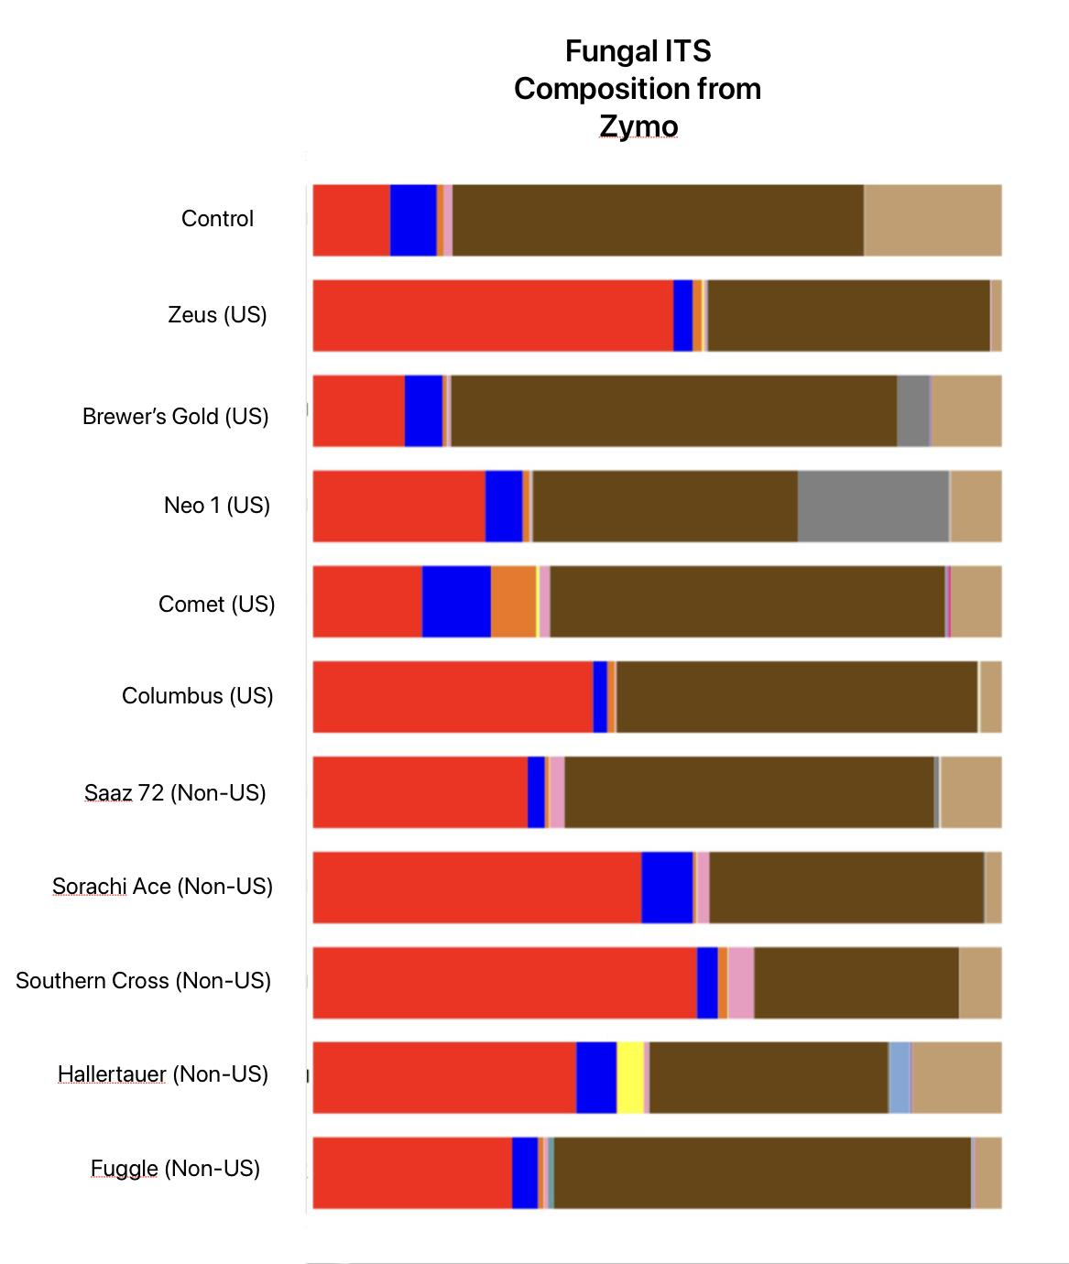
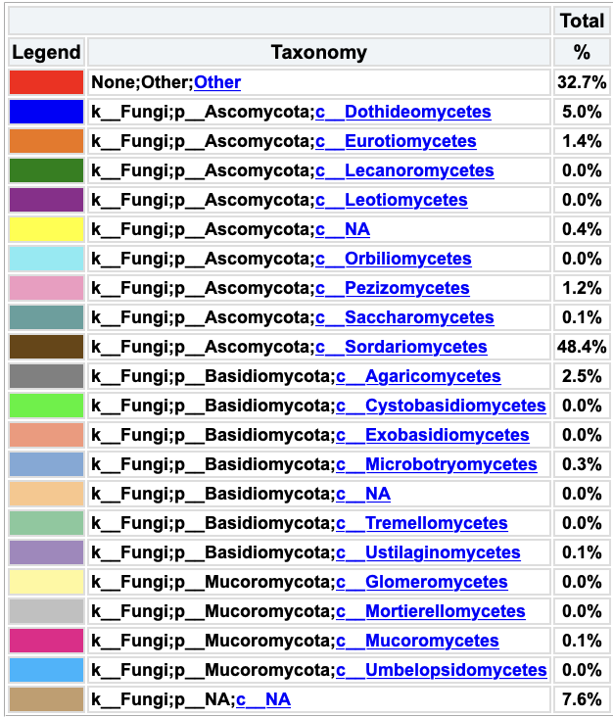
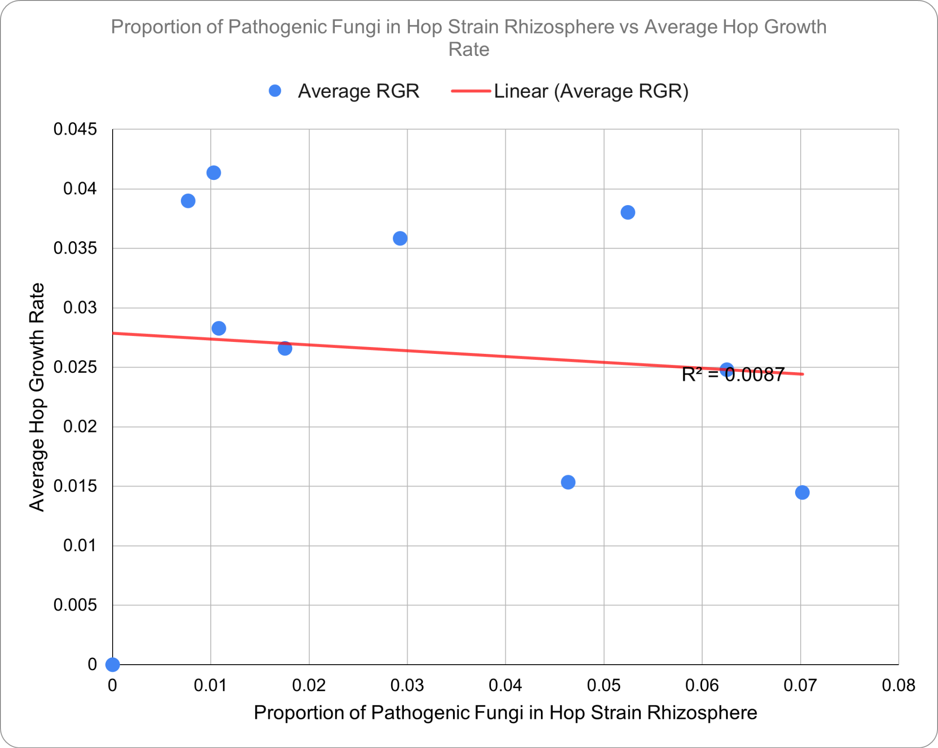
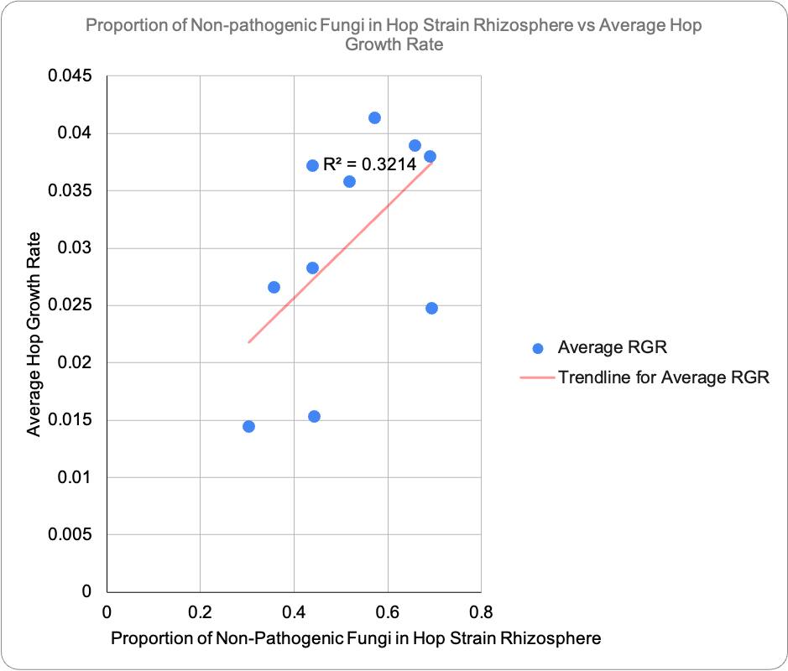
Do Rhizosphere Fungal Pathogens Constrain Growth Rates of Hop Cultivars?
Nathan Salcedo, Jacob Eslava, George Vourlitis, Arun Sethuraman
Department of Biology, San Diego State University; Department of Biological Sciences, California State University San Marcos
Introduction
Discussion
Fungi are a diverse group of eukaryotes that have existed for a rather long time. Most commonly observed fungi include mushrooms, yeasts and molds, wherein their roles in nature are to decay and recycle the carbons and nutrients found in the environment, often contributing the rhizosphere of a plant. However, there are several species of fungi that are pathogenic to other organisms. In this study, we extracted soil from hop samples cultivated in a common-garden greenhouse experiment, that seemed to be afflicted by fungal infections in order to identify fungi found in the local rhizosphere. The goal of this study is to conclude whether there was a clear relationship between the overall growth rates of hop cultivars and the overall abundance of pathogenic and non-pathogenic fungi found in their rhizospheres.
We surmised that there would be a clearer association between the amount of fungi in the rhizosphere and growth rates of hop cultivars. We had based this hypothesis on the fact that many of the hops in the CSUSM greenhouse were afflicted with a disease commonly associated with fungi, and did show signs of other pathogens. However, statistical analyses of all cultivars, for both pathogenic and non-pathogenic fungi suggest a non-significant relationship between the US or non-US hops’ growth and the abundance of fungi, specifically in the case of pathogenic fungi, due to the outlier, Neomexicanus. Future studies should therefore include larger sample sizes to account for biological and technical replication. We did however find that quite a few fungi that were non-pathogenic to plants were pathogenic to humans. For instance, a majority of the Ascomycota fungi were found to be pathogenic to humans while a majority of Basidiomycota were found to be non-pathogenic to people. Most interesting was the genus Scedosporium, a fungus genus pathogenic to people, which appeared a majority of the time within our hop rhizosphere samples, except in Columbus cultivars.
Figure 1: Fungal ITS composition of US and non-US hop strain rhizospheres via Zymo.
Figure 2: Legend for Fungal ITS composition of US and non-US hop strain rhizospheres via Zymo.
Hypothesis
Hypothesis: There is a clear correlation between the growth rate and the abundance of non-pathogenic and pathogenic fungi in the rhizosphere of hop cultivars. Null hypothesis: There is no correlation between the growth rate and the abundance of non-pathogenic and pathogenic fungi in the rhizosphere.
Conclusion
Results
We conclude that there is an observable correlation between pathogenic versus non-pathogenic fungi and the growth rates based upon Figure 3 and Figure 4, but not statistically significant.
1-tailed, 2-sample, equal variance T-test | P-value
H0: US and non-US strains of hops have the same percentage of pathogenic fungi | 0.1446
H0: US and non-US strains have the same percentage of non-pathogenic fungi | 0.1658
References
This work was funded by USDA-HSI:2022-77040-38529 to PI Sethuraman and co-PIs Vourlitis and Jancovich. Fungi Reference: https://www.ncbi.nlm.nih.gov/Taxonomy/Browser/wwwtax.cgi?id=4751
Figure 3: Linear regression of proportion of pathogenic fungi in hop rhizosphere. Strong outlier Neo-1 was excluded from this plot. Negative correlation of proportion of pathogenic fungi vs average hop growth rate can be seen.
Figure 4: Linear regression of proportion of non-pathogenic fungi in hop rhizosphere. Positive correlation of proportion of non-pathogenic fungi vs average hop growth rate can be seen.

