Slide 1
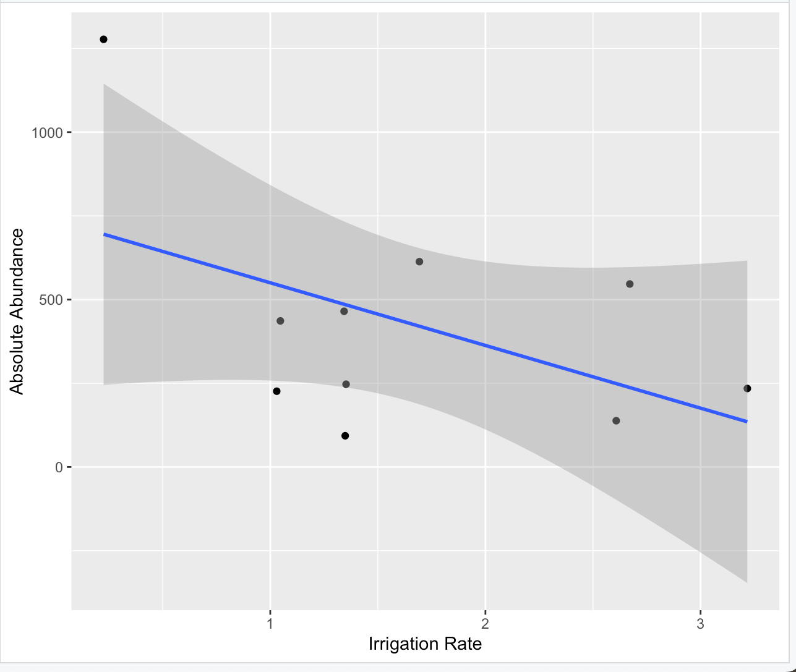
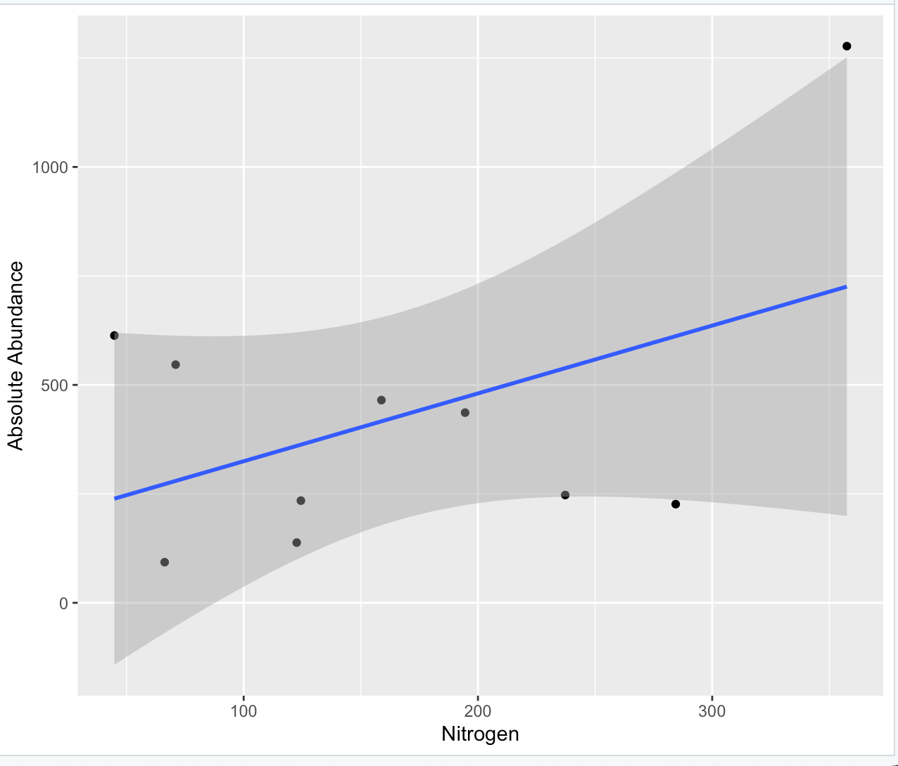
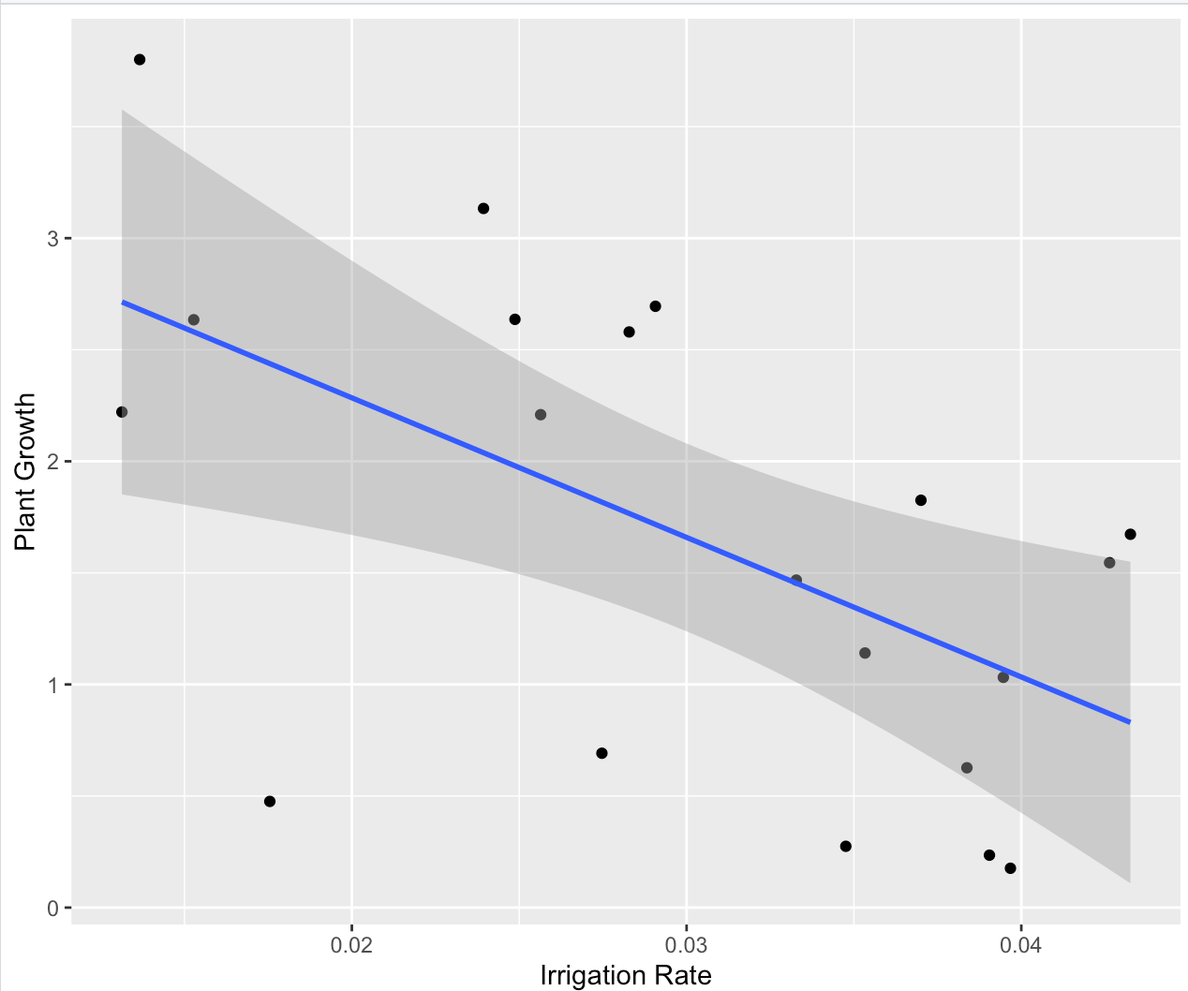
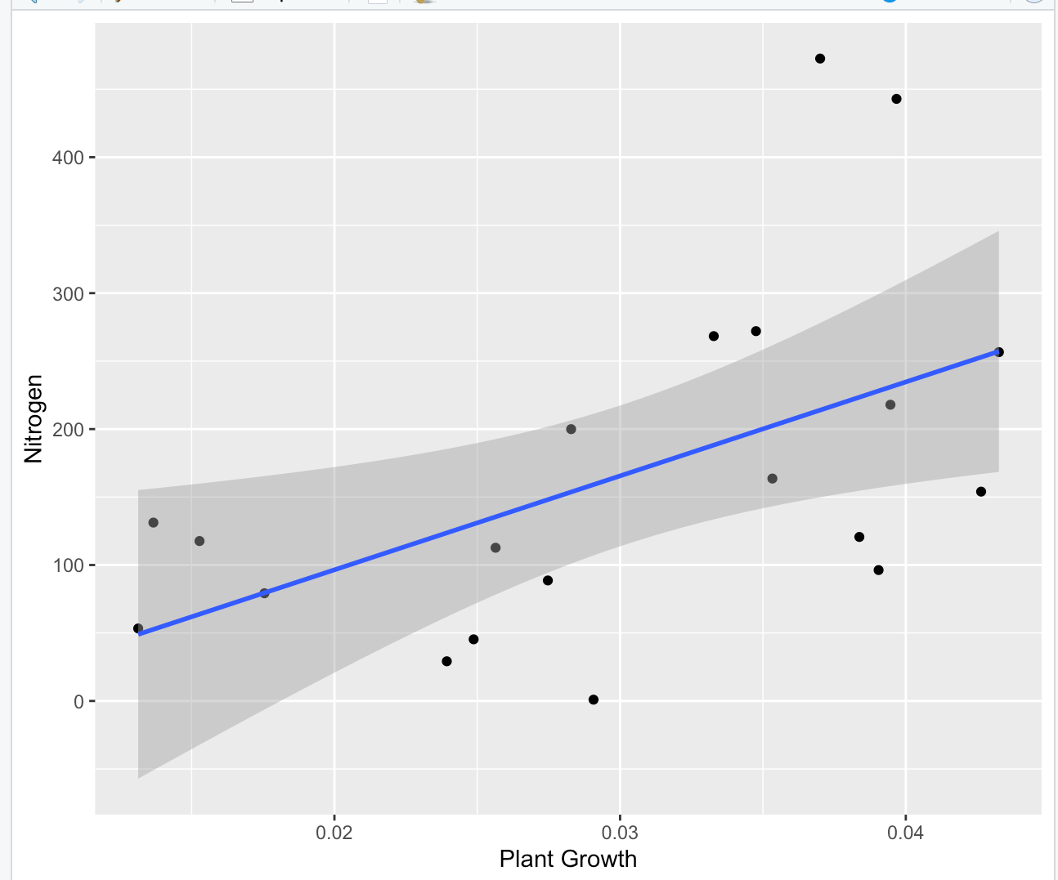
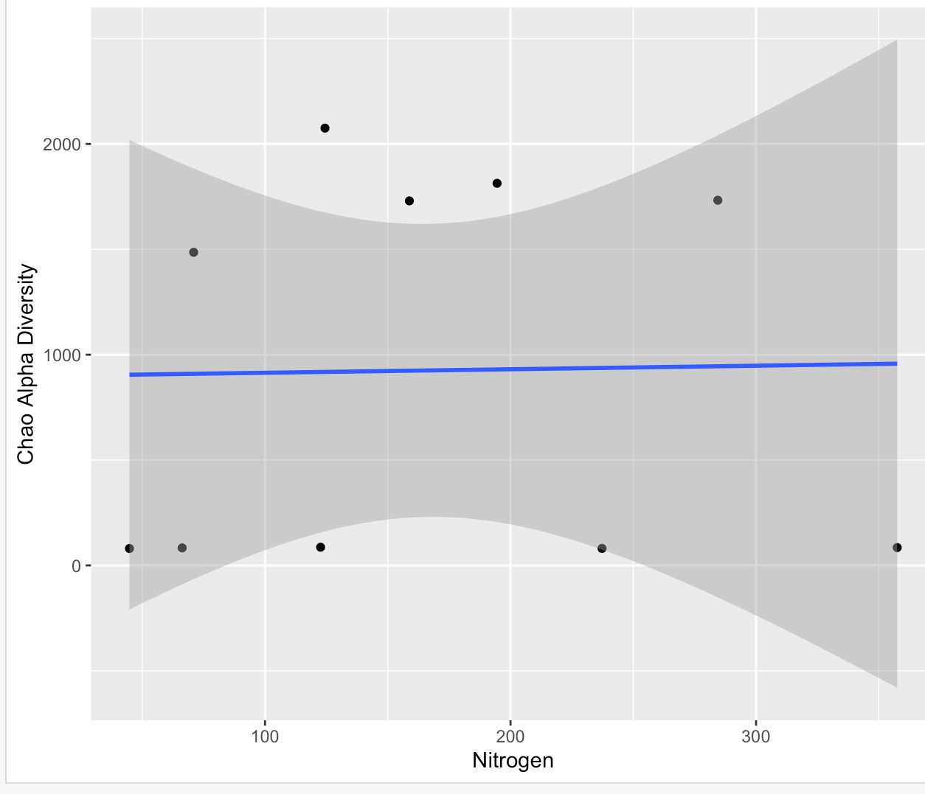
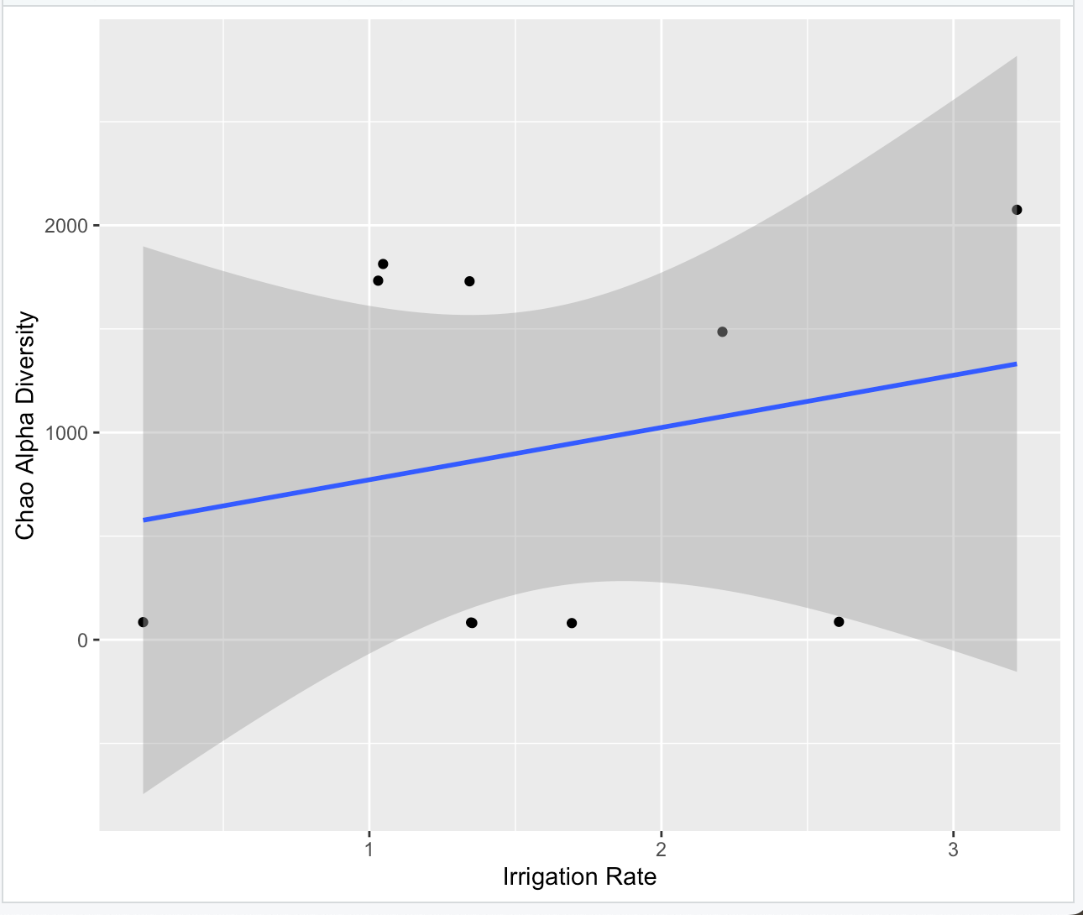
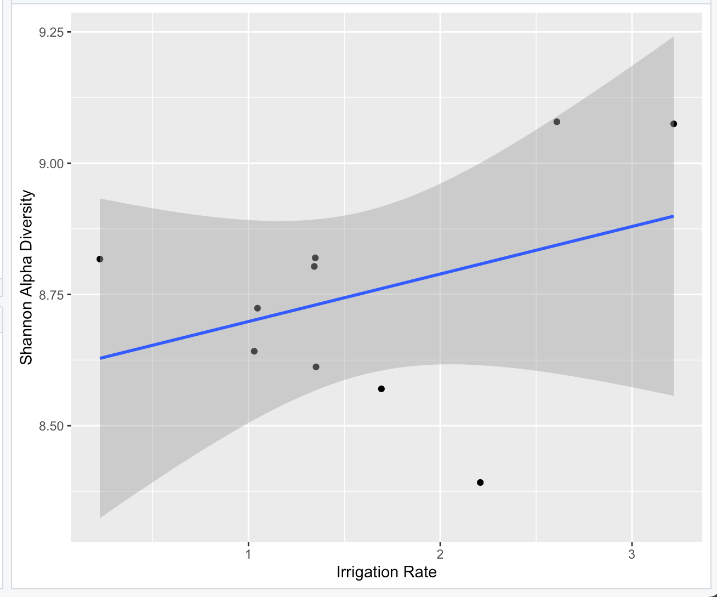
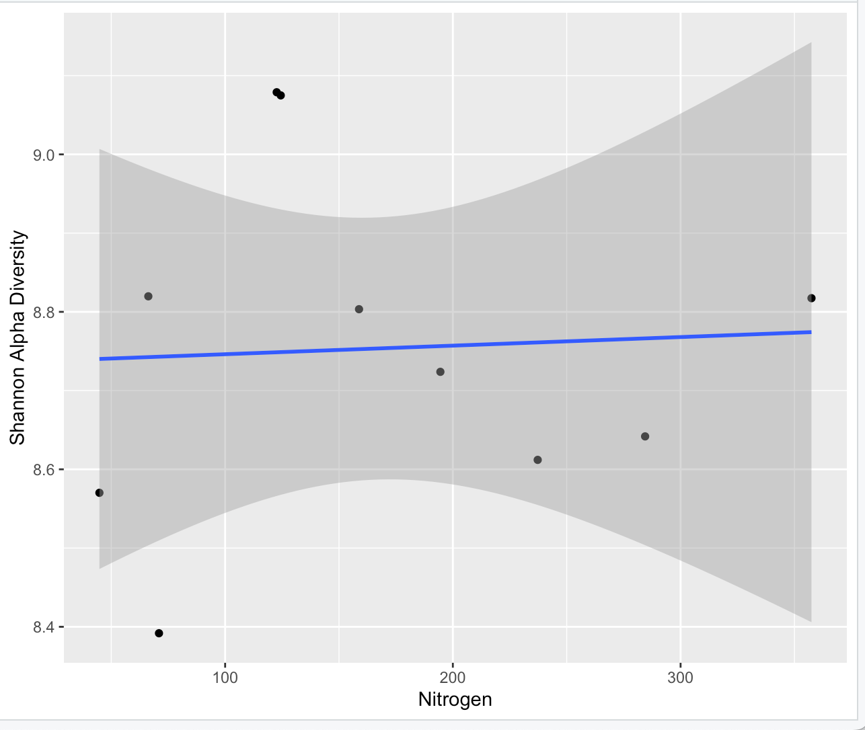
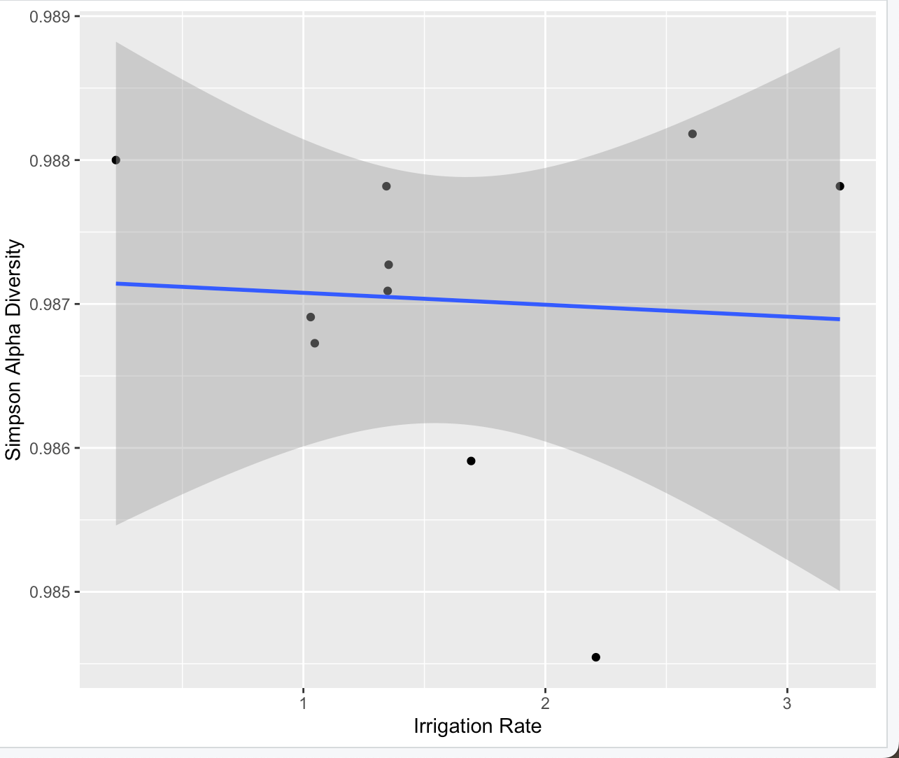
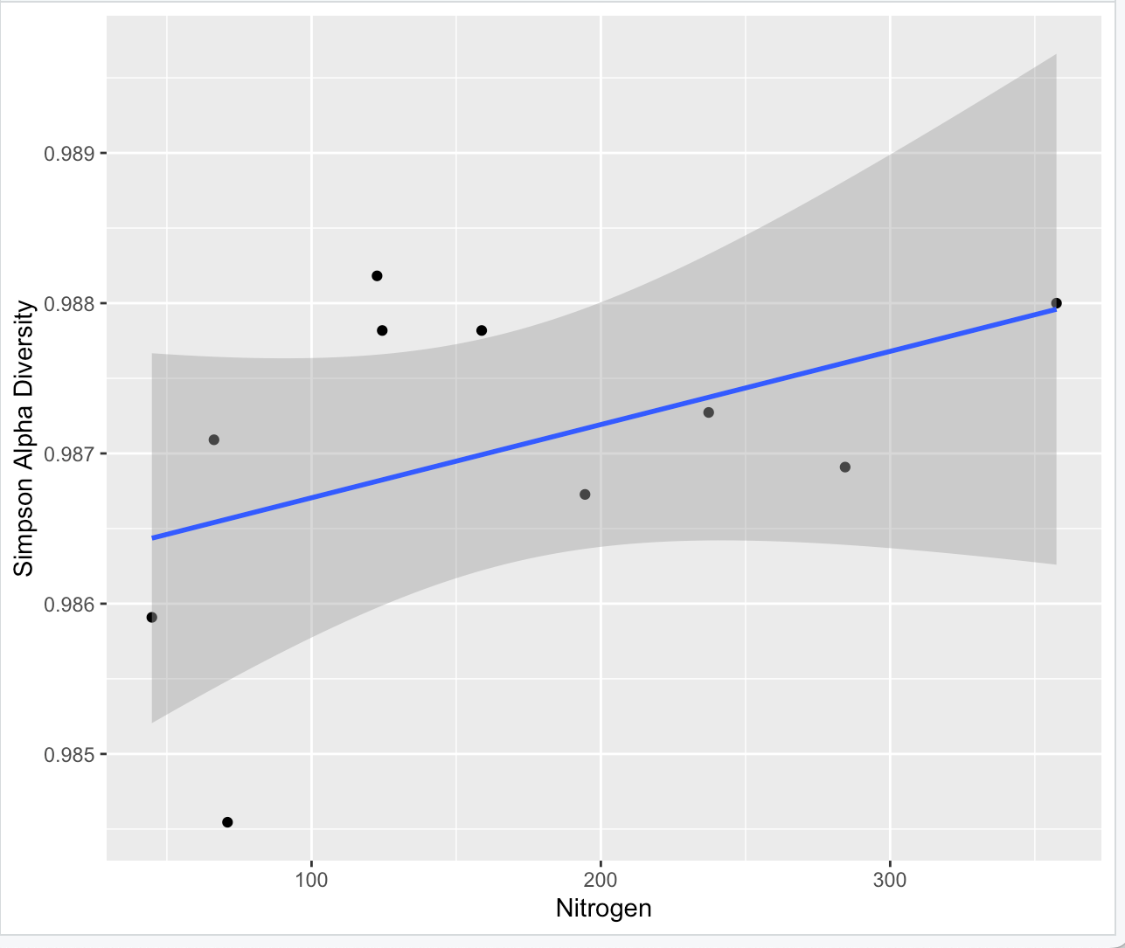
Hops and Soil: A Close Look at Moisture and Microbes
Amran Mohamed, Fatum Noor, Lexi Dockter, George Vourlitis, Arun Sethuraman
San Diego State University, California State University San Marcos
BACKGROUND
RESULTS
RESULTS
RESULTS CONTINUED
Moisture content is a pivotal factor shaping soil health, influencing microbial communities and, consequently, the growth rate of crops. This study investigates the interplay between moisture content, microbial abundances, and growth rates in cultivars of Humulus lupulus L. (hops) at the California State University San Marcos (CSUSM) Greenhouse, with a specific focus on the interplay of key variables—irrigation, nitrogen content, water availability, and microbial diversity—in shaping the soil ecosystem for optimal growth.
We were able to compare the amounts of the moisture content between the strains and found more diverse strains exhibit increased moisture content but lower overall microbial content. Lower moisture content constraints microbial activity, limiting overall microbial abundance. Conversely, greater diversity, coupled with increased moisture, fosters a more favorable environment for microbial communities.
To unravel these trends, we utilized R Studio for processing and analyzing the data. This powerful tool facilitated the exploration of relationships between irrigation, nitrogen content, and microbial dynamics within the diverse soil strains.
Despite the expectation of a positive correlation, the data indicates a negative relationship, with higher soil moisture associated with lower microbial abundance. This unexpected finding challenges conventional assumptions about the impact of water availability on microbial content. The variability among hop varieties, notably the outlier Neo, suggests that additional factors play a significant role in shaping the microbial ecosystem
Hop varieties show a positive correlation between nitrogen levels and microbial abundance, while others show a slight negative correlation, with decreasing nitrogen levels causing a decrease in microbial abundance.
While some varieties show a positive correlation, with higher RGR associated with increased soil moisture, others exhibit a negative correlation. Notably, Sorachi Ace and Hallertauer show increased growth with higher soil moisture, challenging the assumption of a consistent positive relationship.
5. DIN ( Nitrogen) vs Absolute Abundance
9. RGR (Plant Growth) vs sW20
This presents a complex pattern between the hop varieties. Although this is a mostly positive correlation, with higher RGR associated with increased nitrogen levels, others show a less straightforward relationship. Such as an increased growth with higher nitrogen levels which challenges the consistent positive correlation.
sW20 vs Absolute Abundance
Contrary to expectations, the analysis of soil moisture (sW20) in relation to microbial diversity, as measured by the Chao index, reveals a surprising trend. While there is variability among hop varieties, higher soil moisture is associated with lower microbial diversity.
In relation to microbial diversity, as measured by the Chao index, reveals a complex pattern. While some hop varieties exhibit a positive correlation, where higher Nitrogen levels are associated with increased microbial diversity, others show a negative correlation.
10. RGR (Plant Growth) vs DIN(Nitrogen)
STUDY DESIGN AND OBJECTIVES
CONCLUSIONS
Our investigation centered on unraveling the intricate soil relationships within a diverse range of hop strains, including varieties such as Brewers Gold, Columbus, Comet, Fuggle, Hallertauer, Neomexicanus, Saaz 72, Sorachi Ace, Southern Cross, and Zeus. By examining the soil dynamics associated with these distinct hop strains at California State University San Marcos (CSUSM) Greenhouse, we aimed to uncover unique correlations that contribute to a comprehensive understanding of the soil ecosystem supporting hop cultivation.
2. sW20 vs Chao Alpha Diversity
In relation to the Shannon index, despite the anticipated positive correlation, there is noticeable variability among hop varieties. Surprisingly, higher soil moisture does not consistently correlate with increased microbial diversity; instead, the relationship appears nuanced and hop variety-dependent. This unexpected finding challenges the initial hypothesis and suggests that the impact of soil moisture on microbial diversity is more complex than originally assumed, urging a closer examination of the specific factors influencing microbial community composition in this soil ecosystem.
6. DIN (Nitrogen) vs Chao Alpha Diversity
In this study, we employed a comprehensive approach to explore the intricate relationships among hop varieties and their soil environment. The unexpected findings, such as the nuanced correlations between soil moisture, microbial abundance, and diversity challenge our hypothesis of the significant relationship between soil moisture content and nitrogen fixation. It also showed that each hop type has its own unique relationship with soil moisture, microbial activity, and growth.
Future Studies
To understand these interactions better, future studies should investigate the specific details of how soil nutrients and environmental factors influence plant growth. In summary, our study opens the door to a better understanding of how different hops connect with their environment. These insights can lead to more tailored and sustainable farming methods for improved crop management.
Although some hop varieties exhibit a positive correlation, where higher Nitrogen levels are associated with increased microbial diversity, others show a negative correlation.
METHODS
3. sW20 vs Shannon Alpha Diversity
Despite variability among hop varieties, higher soil moisture is associated with a mixed trend in Simpson diversity. While some varieties exhibit an increase, others show a decrease in microbial diversity with higher soil moisture. This nuanced relationship challenges the initial hypothesis of a consistent positive correlation between water availability and microbial diversity, highlighting the complexity of factors influencing the Simpson diversity index within this unique soil ecosystem.
7. DIN (Nitrogen) vs Shannon Alpha Diversity
Conducting a soil chemical analysis on the hop strains involved a meticulous approach. Soil samples were initially collected and prepared for various analyses, including microbial community composition analyses via 16s rRNA sequencing, soil moisture, extractable nitrogen (N), and extractable phosphorus (P). These analyses were vital in understanding the soil dynamics associated with the hop varieties. Post-experiment, the data obtained were subjected to rigorous analysis using R Studio. Leveraging the ggplot functionality, trends and correlations within the datasets were visually represented, providing a comprehensive overview of the intricate relationships among the diverse hop strains.
Some varieties exhibit a positive correlation, where higher Nitrogen levels are associated with increased microbial diversity (evidenced by lower Simpson values), others show a more stable or even negative correlation.
REFERENCES
"Effect of Plant Growth-Promoting Bacteria on the Growth of Micropropagated Lettuce in the Soilless Culture System." Agriculture, vol. 9, no. 4, 2019, p. 179,
Ghanbari, Mahboubeh, et al. "Genotypic Variation in Nitrate Uptake and Utilization by Rice under Different N Supply Levels." Plant Science, vol. 170, no. 3, 2006, pp. 317-323,
ACKNOWLEDGEMENTS
4. sW20 vs Simpson Alpha Diversity
8. DIN (Nitrogen) vs Simpson Alpha Diversity
This work was funded by USDA-HSI:2022-77040-38529 to PI Sethuraman and co-PIs Vourlitis and Jancovich.

