Slide 1
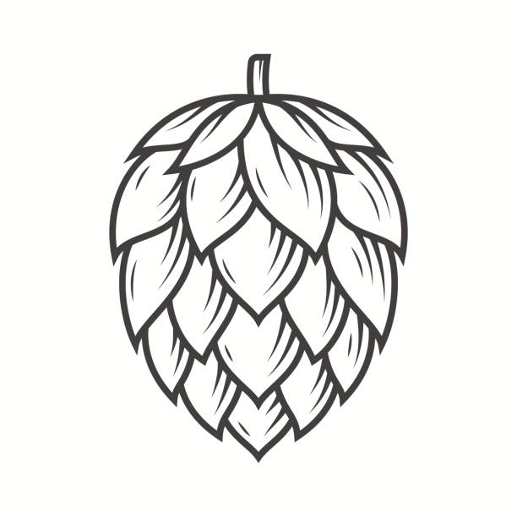
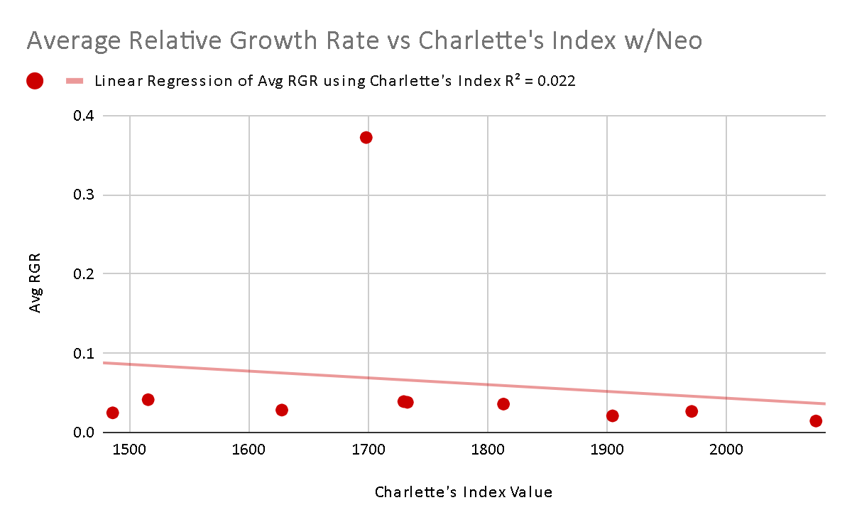
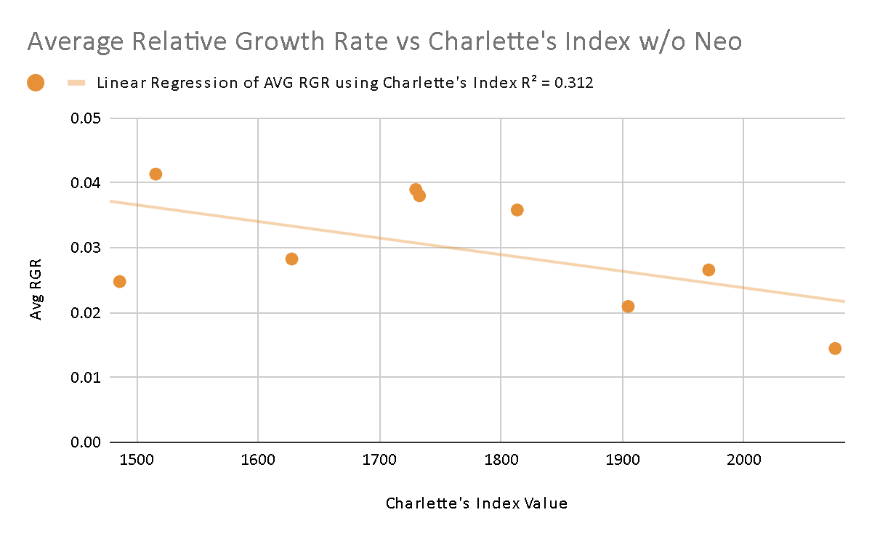
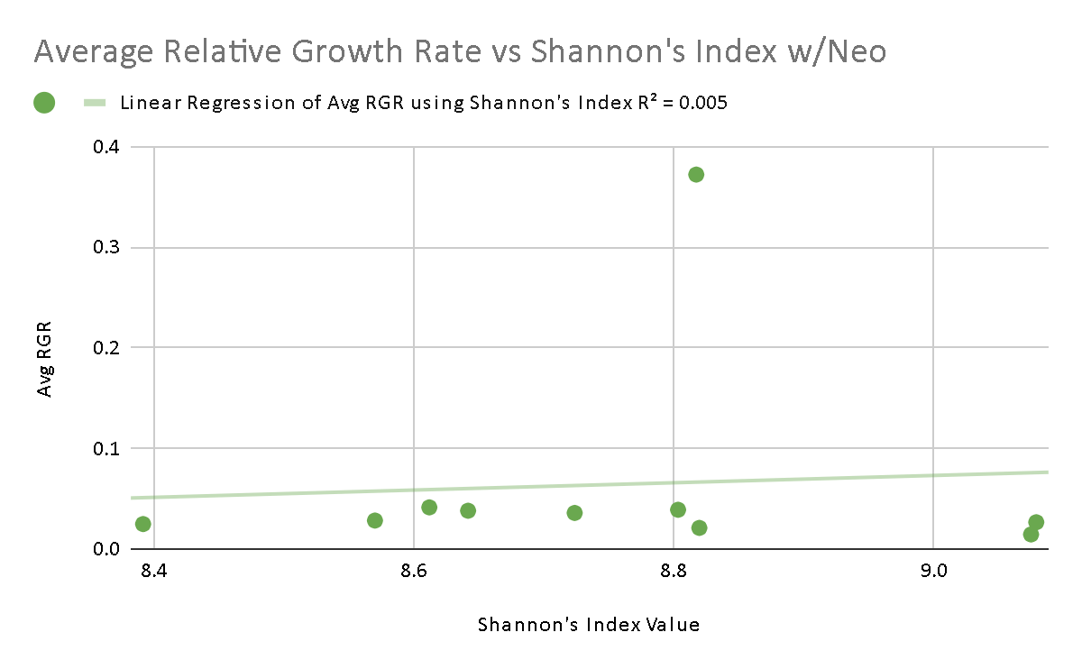
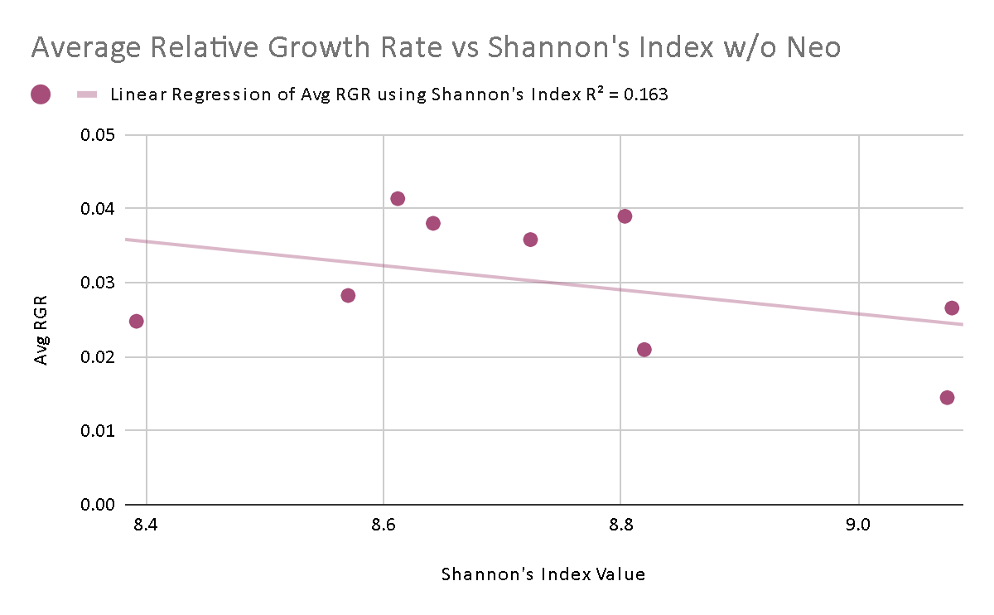
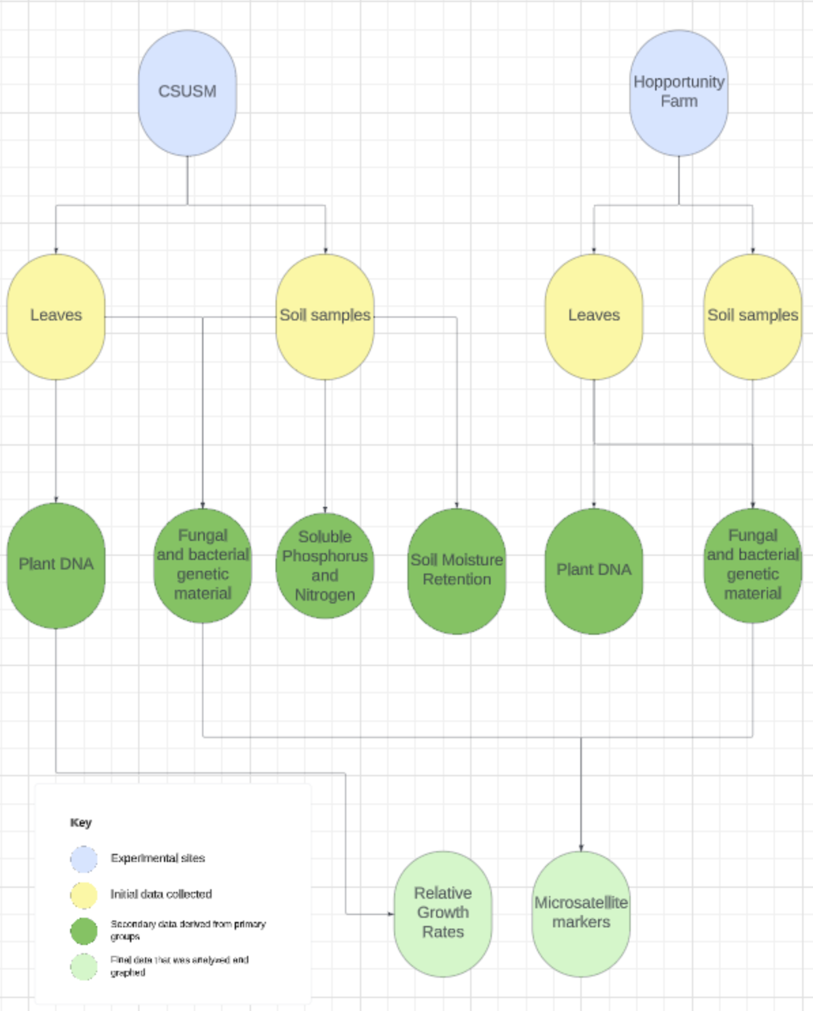
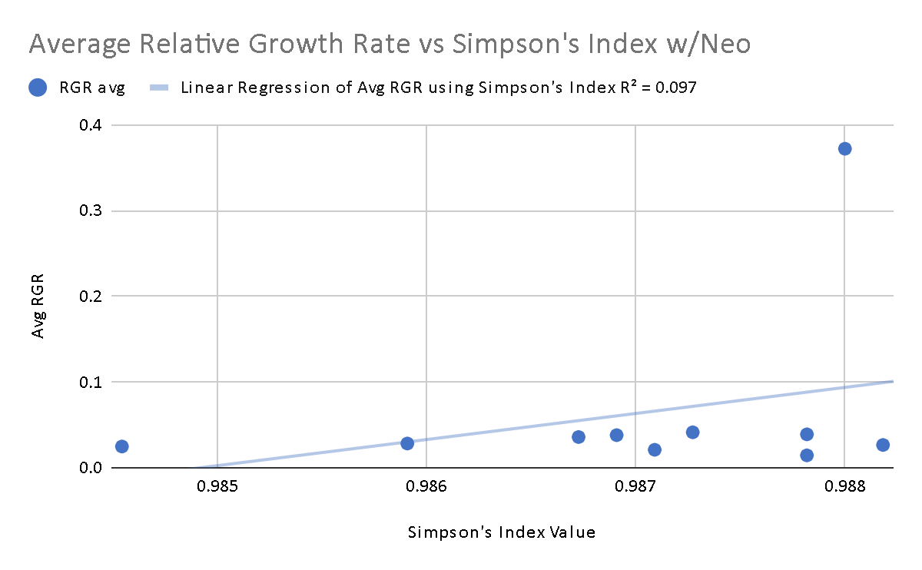
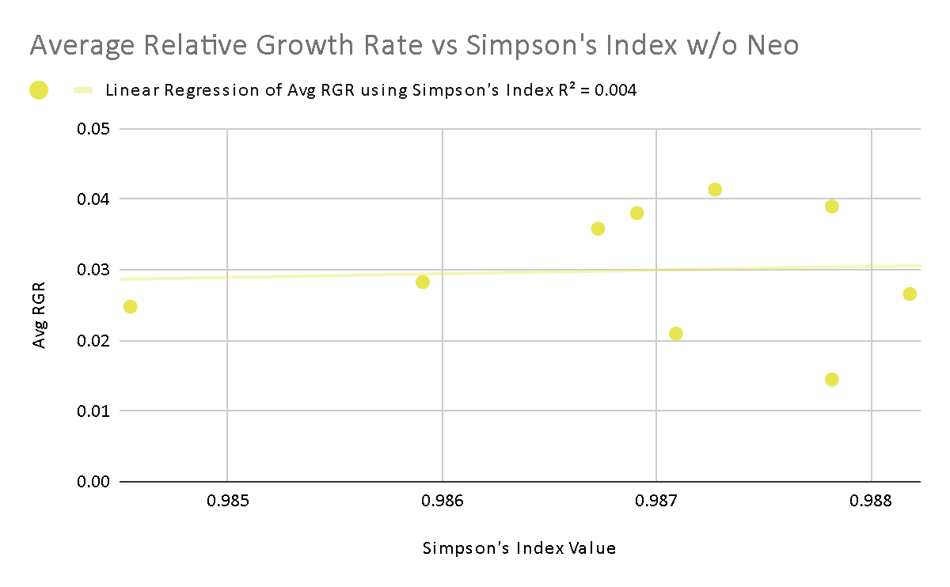
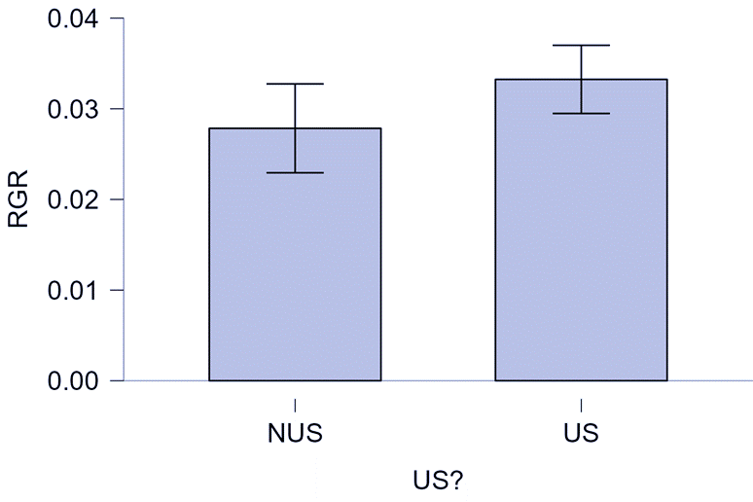
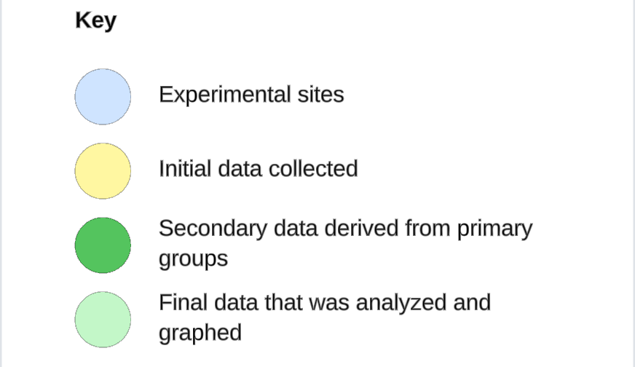
16S Microbial Alpha Diversity's Negative Effect on Relative Growth Rates on US and Non-US Humulus lupulus L. cultivars
Giovanni Gil, Tram Nguyen, Nathan Bingham, Dr. Arun Sethuraman, and Dr. George Vourlitis
Department of Biology, San Diego State University; Department of Biological Sciences, California State University San Marcos
Introduction
Discussion and Conclusion
Results
Globally, cultivars (artificially selected plants that differ significantly from their wildtype ancestors) are bred for optimized crop yield. For instance, Chinese maize cultivars were compared to US maize cultivars to seek "high-yield and nutrient use efficiency...by using new cultivars which can absorb and utilize nutrient resources efficiently and produce high grain yield" (Chen).
Plants curate specialized microbial communities (also known as their rhizosphere) around their root systems but "the transition from natural to agricultural systems may have hampered beneficial interactions between plants and microbes due to loss of soil microbial diversity....hence, the lack of...microbial communities...in dissimilar agricultural landscapes, made human interventions even more critical to maintain a healthy and productive crop" (Pérez-Jaramillo).
Hops or Humulus lupulus L. are an important cultivar for the US GDP since it generates over half a billion dollars USD annually from hop productions alone, not accounting for the GDP generated from downstream products.
In this experiment, we compared microbial diversity between US-based and Non-US based hop cultivars and their effects on growth rates in the San Diego region.
Our data comprised of the 16s rRNA Alpha-diversities across 10 samples consisting of 5 US and 5 non-US cultivars.
There is no significant difference in average growth rate between US vs. Non-US cultivars, except for neomexicanus, which showed significantly higher relative growth rates, compared to all other cultivars.
The relationship between soil microbial diversity and average growth rate demonstrates a negative linear association, showing a decrease in growth rate when the alpha diversity of microbiomes increases (Figure 1, 2, 4).
However, it seems that neomexicanus cultivars were not negatively affected by the same given microbial ecosystem, under a common-garden setting.
Figure 1: Downward trend of relative growth rate against Charlette's index correlation value.
Figure 2: Downward trend of relative growth rate against Charlette's Index correlation value W/O neomexicanus.
Figure 3: Upward trend of relative growth rate against Shannon's Index correlation value.
Figure 4: Downward trend of relative growth rate against Shannon's Index correlation value W/O neomexicanus.
Methodology
Plant DNA extraction method:
Macherey-Nagel NucleoMag Plant February 2023/Rev 08
Plant DNA quantitative and qualitative referencing machinery:
Thermo Scientific NanoDrop 2000c Spectrophotometer
Life technologies Qubit 3.0 Fluorometer
Hop cultivars used include 5 US-based and 5 Non-US based with 2 replicates per cultivar
US based cultivars: Brewer’s Gold, Columbus, Comet, neomexicanus,
Zeus
Non-US based cultivars: Fuggle, Hallertauer, Saaz 72, Sorachi Ace,
Southern Cross
DNA samples sent for analysis to Zymo Research and produced alpha and beta diversities of both bacterial and fungal communities present within the rhizospheres of all 10 kinds of cultivars
Metagenomic analysis and comparison of sample results in order to determine the relativity of average growth rate against bacterial diversities when compared between US-based and non US-based cultivars.
Figure 5: Upward trend of relative growth rate against Simpon's Index correlation value.
Figure 6: Neutral trend of relative growth rate against Simpson's Index correlation value W/O neomexicanus.
Graphs generated in this column included all cultivar relative growth rates
Graphs generated in this column excluded the most significant outlier of relative growth rate (Humulus lupulus var. neomexicanus)
Acknowledgements
Chen, F., et. all, (2020, December 13). Breeding for high-yield and nitrogen use efficiency in maize: Lessons from comparison between Chinese and US cultivars. Advances in Agronomy. https://www.sciencedirect.com/science/article/abs/pii/S0065211320301048
Pérez-Jaramillo, J.E., Mendes, R. & Raaijmakers, J.M. Impact of plant domestication on rhizosphere microbiome assembly and functions. Plant Mol Biol 90, 635–644 (2016). https://doi.org/10.1007/s11103-015-0337-7
This work was funded by USDA-HSI:2022-77040-38529 to PI Sethuraman and co-PIs Vourlitis and Jancovich
Figure 7: Comparison of growth rates between US and Non-US based cultivars

